Slide 1
Node JS – Basic Modules
S.Karthiga,
Assistant Professor,
Department of IT, TCE.

Slide 2
Session Outcomes
At the end of this session, students will be able to,
Apply node js – modules for the given problem

Slide 3
Node JS - Modules
Consider modules to be the same as JavaScript libraries.
A set of functions you want to include in your application.
Paths – deals with file paths
Operating System (os)
File System (fs)
URL (url)

Slide 4
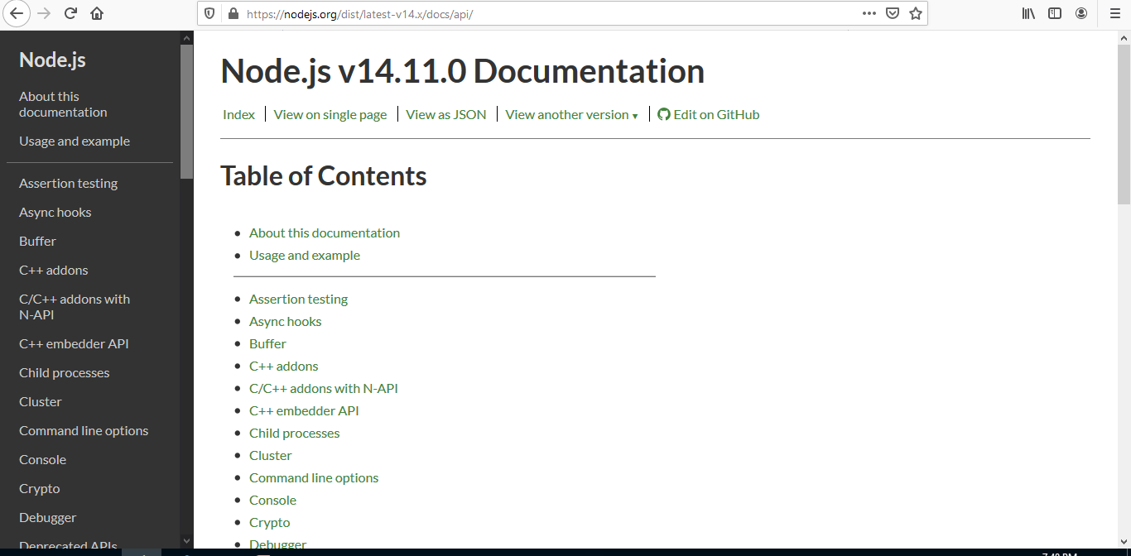
https://nodejs.org/

Slide 5
require()
To include a module
Ex: -
var http = require('http');

Slide 6
Path.js
To interact with file paths easily.
The path module has many useful properties and methods to access and manipulate paths in the file system.
Ex: -
const path=require('path');
var pathObj = path.parse(__filename);
console.log(pathObj);

Slide 7
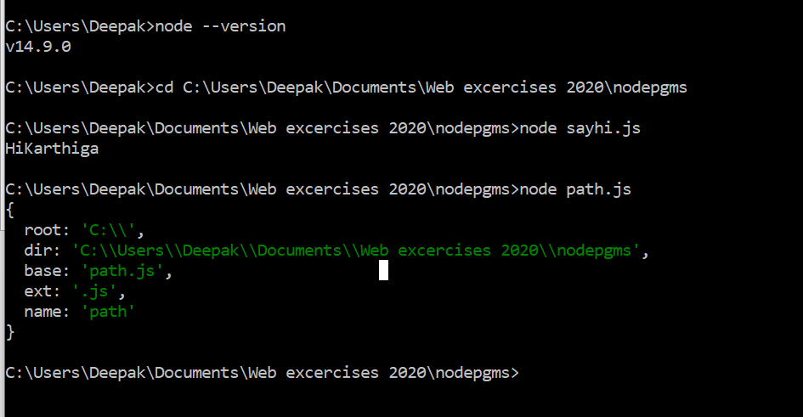
Path – code & output

Slide 8
OS Module
It provide information about the computer operating system.
This provides the functions to interact with the operating system.
The hostname of the operating system can be found and returns the amount of free system memory in bytes.

Slide 9
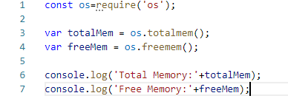
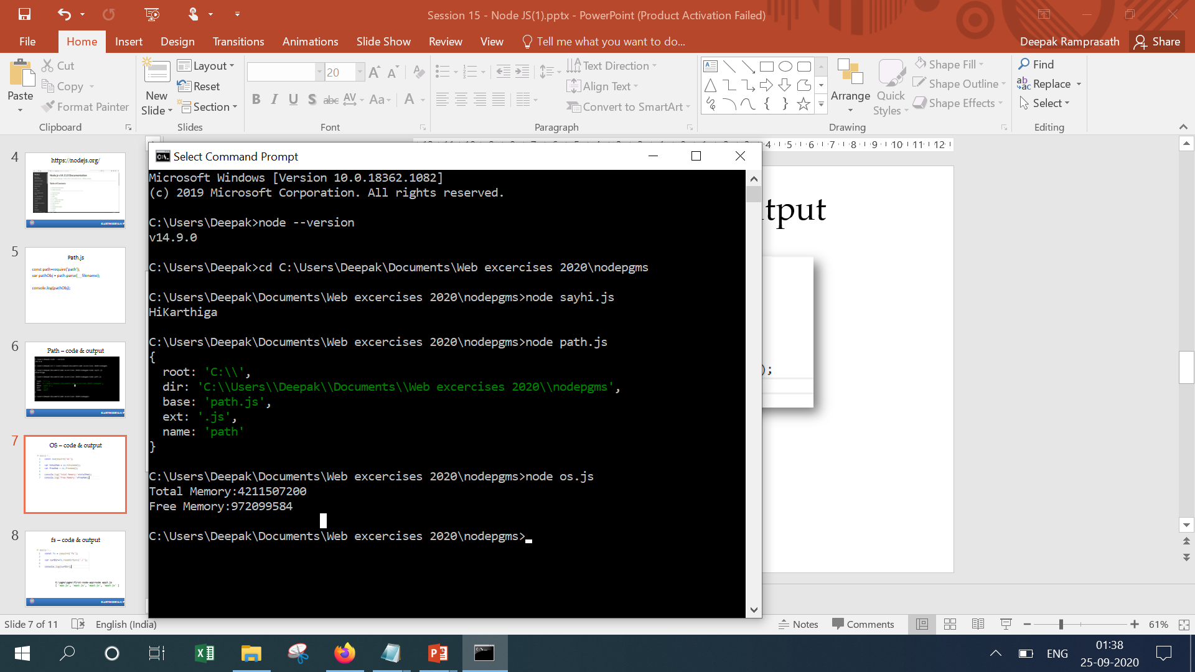
OS – code & output

Slide 10
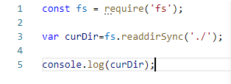
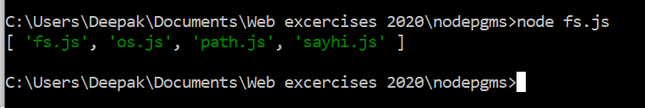
fs – code & output

Slide 11
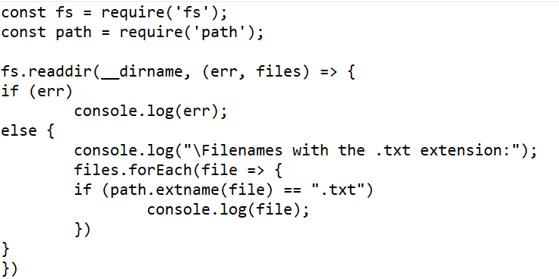
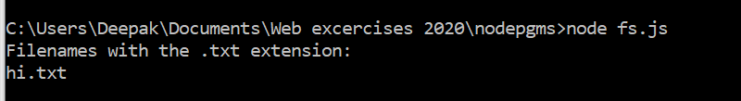
fs – code & output

Slide 12
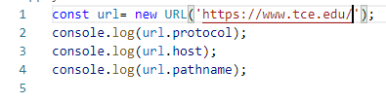
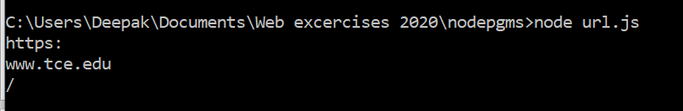
url – code & output

Slide 13
Demo

